Slide 1
WELCOME

Slide 2
North Delta would like to acknowledge the traditional territory of the Tsawwassen and Musqueam First Nations and all the Hul’q’umi’num speaking people who have been stewards of this land since time immemorial. We would also like to offer our respect to all the Elders who have gone before us and to all Canadians who are on the journey of Reconciliation. would also like to offer my respect to all the Elders who have gone before us and to all Canadians who are on the journey of Reconciliation.

Slide 3
Administration
Principal
Mr. Aaron Akune (Gr. 12s)
Vice Principals
Mr. Ben Scarr (Gr. 8s & 10s)
Mr. Kevin Dalgetty (Gr. 9s & 11s)

Slide 4
Counsellors and SLO
School Liaison Officer –
Constable Jessy Sahota
Counsellors
Ms. Cipriano: Gr 12 last name A-D, Gr 9
Ms. Blouin: Gr 12 last name E-K, Gr 10
Ms. Bousserska: Gr 12 last name L-Q, Gr 11
Mrs. Luddu: Gr 12 last name R-Z, Gr 8

Slide 5
CYCWs, Lunch Supervisors, Office and Custodial Staff
CYCWs – Rob Grewal, Chase Rivera, Kim Ruddell, Ikjot Sandhu
Reception – Ms. S. Clarke
Lunch Supervisors
Ms. Servai, Ms. Genzel, Ms. Fix
Daytime Custodian
Ms. B. Sangha

Slide 6
Daily Bell Schedule (Mon, Tues, Thurs, Fri)
8:30 a.m. – 9:40 a.m. Period 1
9:45 a.m. – 10:20 a.m. Individualized Learning Time
10:25 a.m. - 11:35 a.m Period 2
LUNCH
12:20 p.m. – 1:30 p.m. Period 3
1:35 p.m. – 2:45 p.m. Period 4

Slide 7
Bell Schedule (Wed)
8:30 a.m. – 9:30 a.m. Teacher Collaboration Time
9:30 a.m. - 10:35 a.m. Period 1
10:40 a.m. – 11:45 a.m. Period 2
LUNCH
12:30 p.m. – 1:35 p.m. Period 3
1:40 p.m. – 2:45 p.m. Period 4

Slide 8
Rotating Schedule
Day 1 Day 2 Day 1 Day 2
A B A B
ILT ILT ILT ILT
B A B A
LUNCH LUNCH LUNCH LUNCH
C D C D
D C D C

Slide 9
Wednesday Start Time
North Delta has a different start time every Wednesday. School starts at 9:30am sharp. All other days start at 8:30am.
There is no Individualized Learning Time on Wednesdays.

Slide 10
Individualized Learning Time (ILT)
Takes place Mon, Tues, Thurs, Fri for 35 mins
Mon - students report to Bl. A class
Tues - students report to Bl. B class
Thurs - students report to Bl. C class
Fri - students report to Bl. D class
During ILT, students direct their own learning (group learning, assignments, help from teacher, review and study)

Slide 11
Lockers
Each student has the opportunity to be assigned a locker this year. Students should have signed up for a locker using a QR code.
Grade 8-10 students received a lock.
Grade 11-12 students require their own lock.
Students should have an extra lock for PE class
Additional locks can be purchased from the office

Slide 12
School Photos
School photos took place on Thurs, Sept. 15th.
Photo Re-takes take place on Tues, Oct 18.
School photos can be ordered directly from Artona.

Slide 13
Code of Conduct
All students are expected to follow the School and District Code of Conduct.
All students must contribute to a safe, caring and orderly environment. Students need to respect the rights of others and the larger community to which they belong.
The positive behaviours students should demonstrate are embodied in the Husky PRIDE matrix.

Slide 14
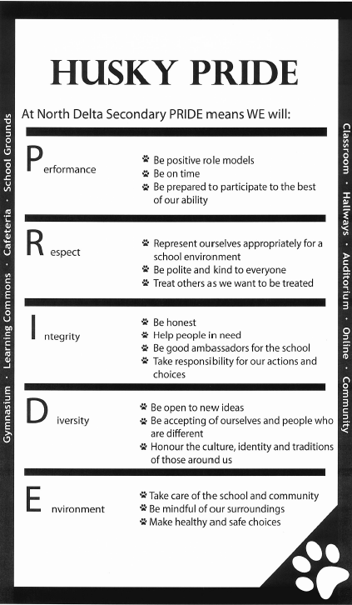

Slide 15
Code of Conduct
BE ON TIME AND READY TO DO YOUR BEST.
TAKE PRIDE AND RESPONSIBILITY FOR YOUR ACTIONS. LEARN FROM YOUR MISTAKES.
Class Time = Time to Learn Before School, At Lunch and After School = Time to Hang Out With Friends

Slide 16
Drop-Off & Pick-Up
Drop students off early so they are on time for class
Drop-off lane at front of school is closed in the afternoon for safety reasons
Decide on drop-off and pick-up locations a short distance from school in order to reduce congestion
Front Lot (82 Ave) and Rear Lot (83 Ave) are available for parent/visitor parking

Slide 17
Student Absences
Report student absences / early dismissals
Phone: 604-596-7471
Email: northdelta.sec@deltaschools.ca
Note from parent/guardian
In the case of multi-day/extended absences, student and parent/guardian should connect with teacher through email.

Slide 18
Parent Engagement
Newsletters / Website / App / Parent Connect
PAC Meetings
Monitor student progress
Interim reports, report cards, Parent-Teacher Interviews
Contact staff member
Phone main office: 604-596-7471
Email: ----@deltaschools.ca

Slide 19
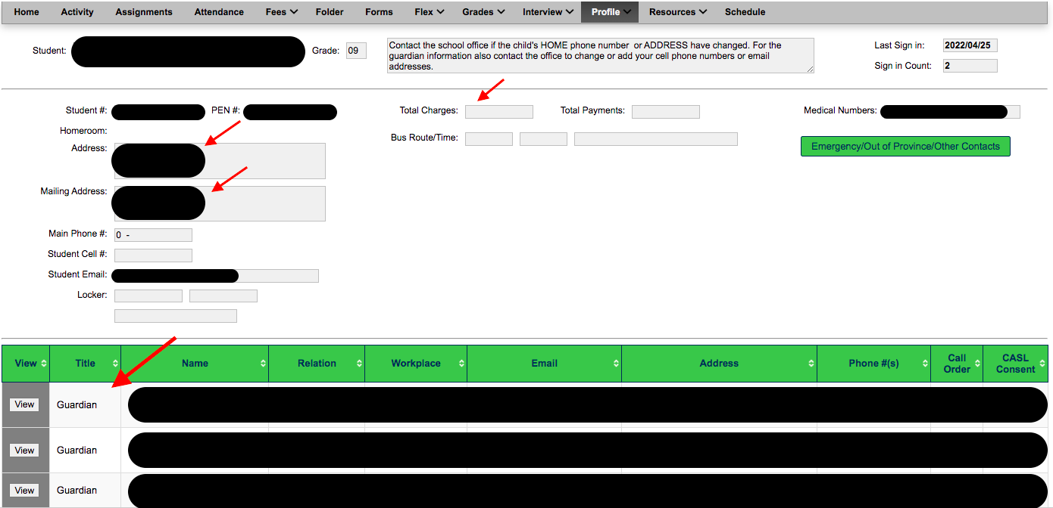
Parent /Guardian Contact Information
Update demographic information

Slide 20
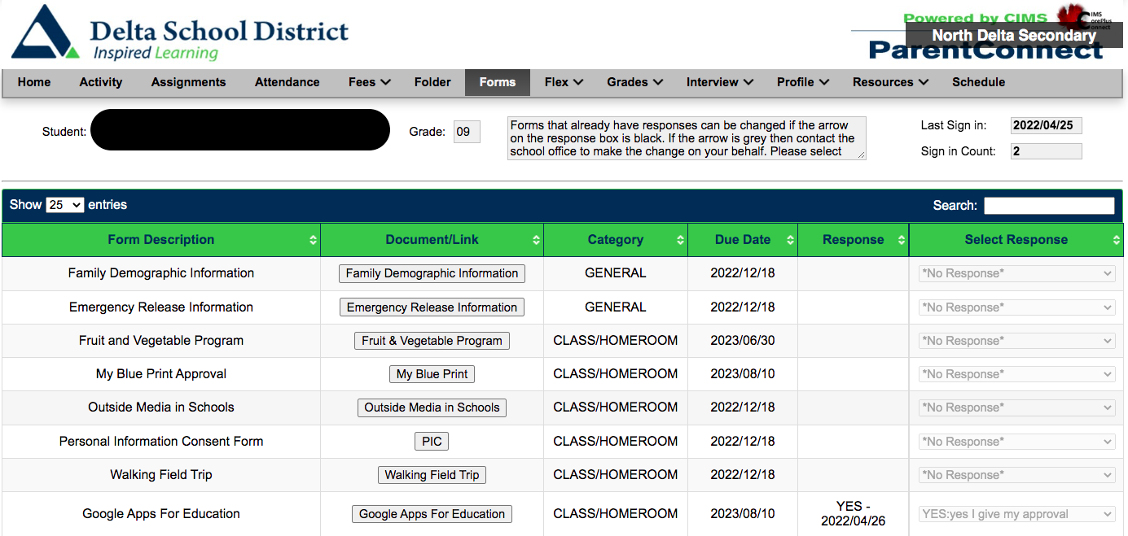
Annual Permission Forms
Provide consent using Parent Connect > Forms

Slide 21
Monitoring Attendance

Slide 22
Reporting
Oct 14 - Interim Reports
Oct 27 - Parent-Teacher Interviews
Nov 17 - Report Card #1
Feb 9 – Report Card #2 (Sem. 1 Final Report)
Mar 9 - Interim Reports
Apr 4 - Parent-Teacher Interviews
Apr 27 - Report Card #3
Jun 29 – Report Card #4 (Final Report)

Slide 23
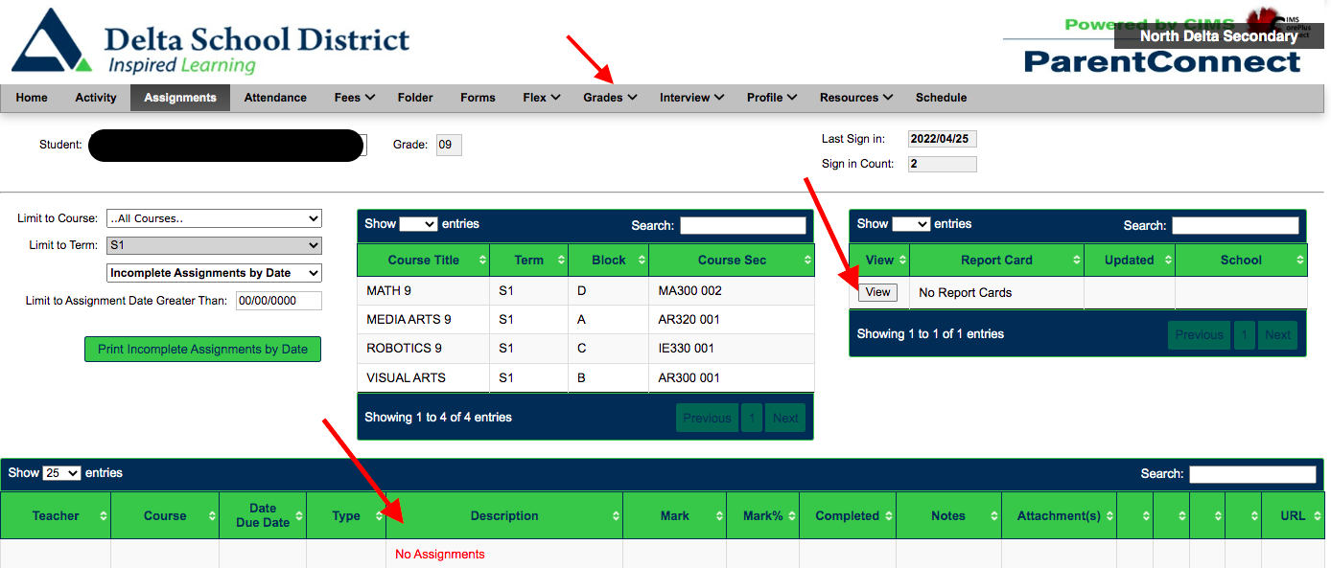
Monitor Student Learning

Slide 24
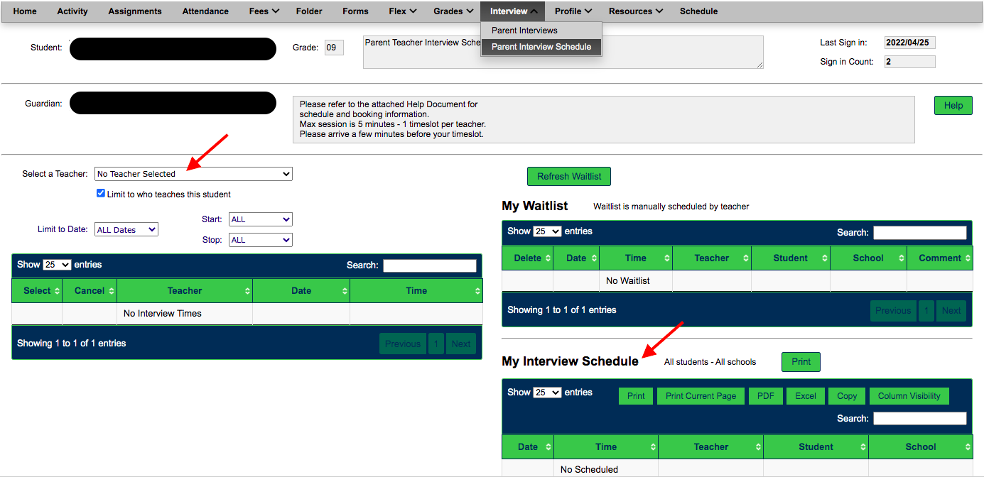
Parent-Teacher Interviews
Oct 27 2:00-4:00pm / 5:00-7:00pm

Slide 25
Staying Informed
North Delta App
ND School Website
Weekly Husky Highlights Newsletter
ND Twitter - @north_delta
Instagram - @ndhuskies
DHA - @DeltaWildHockey
P.A. Announcements

Slide 26
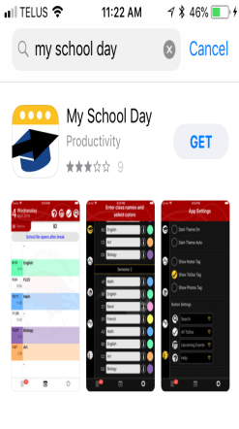
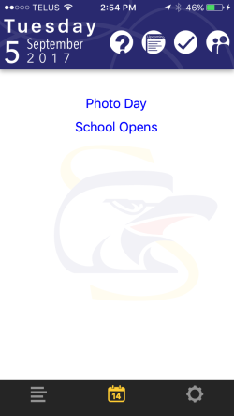
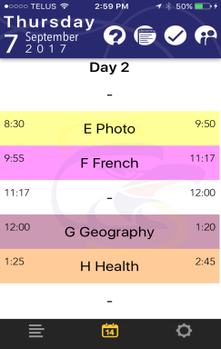
Staying Informed

Slide 27
Career Education 8 & 9
Career Ed. 8 & 9 are non-enrolling courses
All Grade 8 & 9 students will be required to sign up for a Career Ed Google Classroom
Students must submit assignments electronically to Ms. S. Grewal.

Slide 28
Career Life Connections 12
CLC 12 (Capstone) is a non-enrolling course that is required for graduation.
All Grade 12 students will be required to sign up for a Career Ed Google Classroom
Students must submit assignments electronically to Ms. S. Grewal.
Students must complete a Capstone project and present their learning during an in-person interview in February.

Slide 29
Grad Activities
Grad Activities Contract
Important Dates:
Sept 27: Grad Boat Cruise
Jan 23 – Feb 2: Grad Photos
Late Jan/Early Feb: Snowball Dance
May 26: Red Carpet, Banquet, Dry Grad
June 29: Valedictory Ceremony

Slide 30
Thank you for joining us!

